Slide 1
W2D1 Slides
Matthew Tai

Slide 2
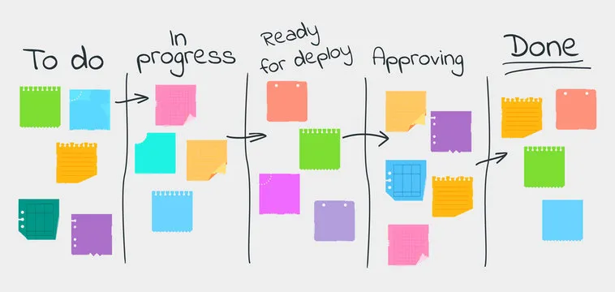
Kanban Framework
Tasks cards are listed under different columns.
Event-driven, cards are moved when tasks are completed.
Phases can be worked on in-parallel.
Specialists can focus on different phases.

Slide 3

Pair Programming
2 developers work on code together at the same computer.
Driver writes code, Navigator plans.
Leads to less errors due to more eyes checking over the code.
Styles:
Unstructured
Driver-Navigator
Ping-pong

Slide 4
Severity and Priority
Severity: How much does this impact the operation of the product?
Critical, Major, Moderate, Minor, Cosmetic
Functionality-Focused
Objective, unlikely to change.
Priority: How soon should this be fixed?
Low, Medium, High
Business-Focused
Subjective and changeable.
The Development team (usually QA Engineer) reports the Severity of defects, but the Product Owner decides the Priority.

